Slide 1

K.L.N. COLLEGE OF ENGINEERING
(An Autonomous Institution, Affiliated to Anna university, Chennai)
DEPARTMENT OF COMPUTER SCIENCE AND ENGINEERING
OPTIMIZING PRODUCT RECOMMENDATIONS WITH LOCATION- BASED DATA USING CATBOOST
GUIDE :
Mrs.R.Kirubahari
Associate Professor 1
Department of Computer Science and Engineering
DOMAIN NAME :
MACHINE LEARNING
TEAM MEMBERS :
SAKTHI AASHITHA N S [910621104078]
SAKTHI JOTHI T S [910621104079]

Slide 2
ABSTRACT
To develop an advanced product recommendation system integrating content-based filtering, collaborative filtering, location-based filtering, and the CatBoost machine learning algorithm for highly personalized suggestions.
To enhance relevance by considering individual user preferences, similar user behaviors, and location-based data.
To incorporate location-based filtering for region-specific recommendations and utilize CatBoost for real-time optimization and dynamic adaptation based on user feedback.
To provide a seamless and engaging shopping experience, improving user satisfaction and boosting conversion rates for businesses.

Slide 3
INTRODUCTION
The system uses machine learning for sophisticated decision-making.
Vision: To provide a personalized shopping experience with tailored, location-based recommendations.
Users select products, and the system combines content-based, collaborative, and location-based filtering for customized suggestions.
Content-based filtering recommends products similar to previous selections and aligns with user preferences.
Collaborative filtering improves recommendations by analyzing similar user preferences, and CatBoost fine-tunes suggestions in real-time.
Location-based filtering ensures relevance to users' geographical contexts, while continuous feedback loops enhance recommendation accuracy and boost conversion rates.

Slide 4
LITERATURE SURVEY
S. No | Paper Title | Year of publication, Vol No., Issue No., PP | Journal Name / Authors | Methodology | Merits/Demerits
1. | OntoCommerce: Incorporating Ontology and Sequential Pattern Mining for Personalized E-Commerce Recommendations. | 18 March 2024,Vol.no:12. | IEEE Explore / Ghulam mustafa, Naveed ahmad jhamat, Zeeshan arshad, Nadia yousaf, Md. nazmul abdal, Mohammed maray, Dokhyl alqahtani, Mohamad amir merhabi, Muhammad abdul aziz, and Touseef ahmad | The methodology combines ontology and sequential pattern mining (SPM) to improve e-commerce recommendations. Ontology captures knowledge about customers and products to identify preference similarities, while collaborative filtering predicts interests. SPM refines these predictions by analyzing purchase patterns, resulting in more accurate and personalized recommendations that address cold-start and data sparsity issues. | Merits : The hybrid system improves recommendation accuracy by combining two methods, making suggestions more personalized and solving problems like limited data. Demerits Static recommendations quickly become outdated, failing to adjust to changing customer preferences or product availability.

Slide 5
LITERATURE SURVEY
S. No | Paper Title | Authors & Publications | Methodology | Merits/Demerits
2. | Location-Based Recommendation System Using Bayesian User's Preference Model in Mobile Devices | Springer/Moon-Hee Park, Jin-Hyuk Hong, and Sung-Bae Cho.Vol.no:4611.Issue 2007. | The methodology involves creating a recommendation system that uses a map to show personalized suggestions based on the user's location and preferences. The system uses a model called a Bayesian Network, which is set up by an expert and then fine-tuned with data. It gathers information like the user's location. Using this information, the system predicts what the user would like and displays the suggestion. | Merits : The system improves user experience by providing personalized recommendations based on the user's location. Demerits : The system may struggle with accuracy if location data is imprecise or outdated and can face privacy concerns due to the continuous tracking of user locations.

Slide 6
LITERATURE SURVEY
S. No | Paper Title | Year of publication, Vol No., Issue No., PP | Journal Name / Authors | Methodology | Merits/Demerits
3. | Product Recommendation System using Machine Learning | Vol.no:9,Issue 11, November 2021. | SSRN / Nitin Kamble.Ajeenkya D. Y. Patil University | The methodology involves collecting and preprocessing Amazon product data, then training a Support Vector Machine (SVM) algorithm on it. The SVM model's performance is compared with traditional recommendation systems and tested for generalizability across various product datasets. | Merits : Using an SVM algorithm can improve the precision of recommendations by effectively handling complex, high-dimensional data, resulting in more accurate product suggestions. Demerits : Training SVM models can be resource-intensive, demanding significant computational power and time, especially when dealing with large volumes of data.

Slide 7
LITERATURE SURVEY
S. No | Paper Title | Authors & Publications | Methodology | Merits/Demerits
4. | Sales Forecasting Based on CatBoost | IEEE Explore / Jingyi Ding; Ziqing Chen; Li Xiaolong; Baoxin Lai.(2020). | The methodology involves gathering and preprocessing the Walmart sales dataset, followed by training a CatBoost model. The performance of this CatBoost model is then compared with traditional methods like Linear Regression and SVM, focusing on its prediction accuracy and generalizability across different datasets. | Merits : Superior Accuracy: CatBoost delivers more precise sales predictions than traditional methods, enhancing the reliability of sales forecasts. Demerits : Resource Intensive:Training CatBoost on large datasets demands significant computational power and time, which might not be practical for all users.

Slide 8
EXISTING SYSTEM
Traditional systems often fail to integrate individual characteristics like location into their recommendation algorithms, resulting in less tailored and relevant suggestions.
They generally do not adapt recommendations in real-time based on user feedback or contextual changes, leading to outdated suggestions that may not align with current user interests.
These systems may struggle with incomplete profiles and data inconsistencies, affecting the accuracy and reliability of recommendations.
Due to the lack of dynamic adjustments and personalization, recommendations can become less engaging and relevant over time.
This can lead to decreased user satisfaction and engagement with the system.
The inability to offer real-time updates and manage diverse user data diminishes the overall effectiveness of the recommendation process.

Slide 9
PROPOSED SYSTEM
Unlike traditional systems, this system integrates location for highly personalized recommendations.
The use of CatBoost enables dynamic adjustments based on user feedback and contextual changes, keeping recommendations up-do-date.
Region-specific suggestions are provided through location-based filtering, tailoring recommendations to local trends and availability.
This system combines content-based filtering (analyzing item features and user preferences) with collaborative filtering (utilizing user behavior patterns) to enhance recommendation accuracy and relevance.
Continuous updates and dynamic personalization increase user satisfaction and engagement.

Slide 10
DATA FLOW DIAGRAM
Start User
Data Collection
Start Feedback Loop
Collect User Feedback
Collect User Similarity
Collect User Preferences
Collect Location Information
Apply Catboost
Update Model
Region-Specific Filtering
Collabrative - Filtering
Content-Based Filtering
Provide Recommendation
Combine Filter

Slide 11
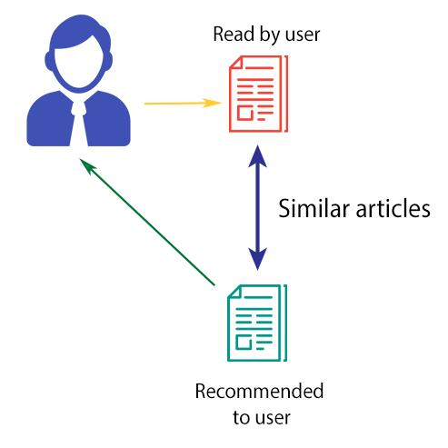


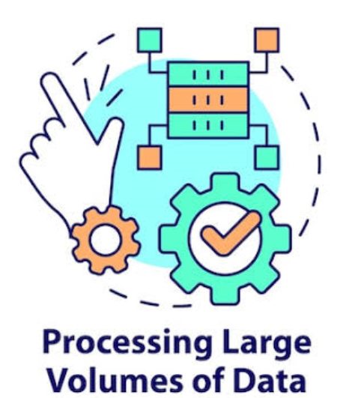
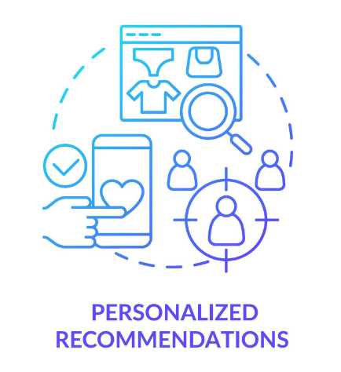
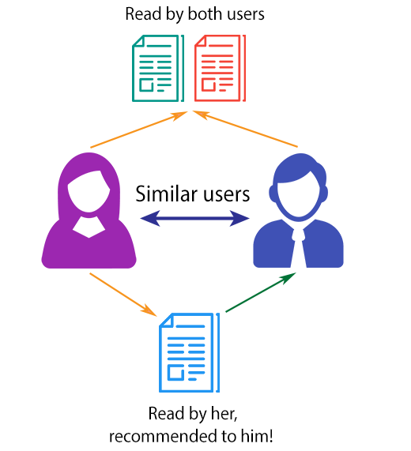

ARCHITECTURE DIAGRAM
Content-based Filtering
Filtering Process
User DataBase
CatBoost Boosting Algorithm
Genrating Personilsed Product Recommendation
Collaborative Filtering
User Location

Slide 12
SYSTEM REQUIREMENTS
4.1 HARDWARE REQUIREMENTS
  CPU: Multi-core (e.g., Ryzen 5th Gen or Intel i5/i7)
  RAM: 16 GB (Minimum)
  Storage: SSD, 256 GB or higher
  Network: High-speed internet connection
4.2 SOFTWARE REQUIREMENTS
  Operating System: Windows Server
  Programming Language: Python 3.x
  Machine Learning Models: CatBoost Classifier
  Libraries: Pandas, NumPy, scikit-learn, Matplotlib, CatBoost
  IDE: Visual Studio Code (VS Code), Google Colab

Slide 13
MODULES
  Data Preprocessing and Location Information
  Content-Based Filtering Using Cosine Similarity
  Collaborative Filtering Using Matrix Factorization
  CatBoost Model Integration and Visualization

Slide 14
DATA PREPARATION AND LOCATION INFORMATON
Load a dataset with product names, stock codes, customer IDs, and purchase quantities to build the recommendation system.
Remove records with missing information, like customer IDs or product names, to ensure data reliability.
Keep essential columns such as product descriptions, stock codes, and purchase history for effective pattern detection.
Convert product descriptions into numerical form using TF-IDF to facilitate content-based recommendations.
Add location details to personalize suggestions based on users’ geographic locations.

Slide 15
  CONTENT-BASED FILTERING USING COSINE SIMILARITY
The system uses cosine similarity to compare product descriptions and identify similar items based on features.
It generates personalized recommendations by analyzing product content, aligning suggestions with the user’s preferences.
The system can find related products using stock codes, enriching recommendations by connecting similar items.
It considers previous user interactions, refining recommendations based on past purchases or interests.
The system adapts its recommendations by merging product content with user preferences for a more tailored experience.

Slide 16
COLLABORATIVE FILTERING USING MATRIX FACTORIZATION
The system creates an interaction matrix linking customer IDs with stock codes and purchase quantities to capture purchasing behaviors.
Truncated Singular Value Decomposition (SVD) processes this matrix to uncover patterns in user preferences.
Collaborative filtering personalizes recommendations based on similar users' purchasing behavior, offering a wider range of suggestions.
The system analyzes hidden patterns to suggest products that align with the interests of similar users.
Recommendations are continuously refined based on user preferences and behaviors, ensuring better product relevance.

Slide 17
CATBOOST MODEL INTEGRATION AND VISUALIZATION
The system uses a CatBoost classifier to enhance product recommendations, ranking items based on predicted user engagement.
Categorical features are managed effectively by CatBoost, ensuring accurate prediction of products the user is likely to engage with.
Top product recommendations are displayed through visual techniques like bar charts, making it easy for users to see the most relevant suggestions.
User feedback is incorporated to dynamically adjust recommendations, ensuring continuous improvement in product relevance.
The system combines both content-based and collaborative filtering methods, refined by CatBoost, for more accurate and personalized suggestions.

Slide 18
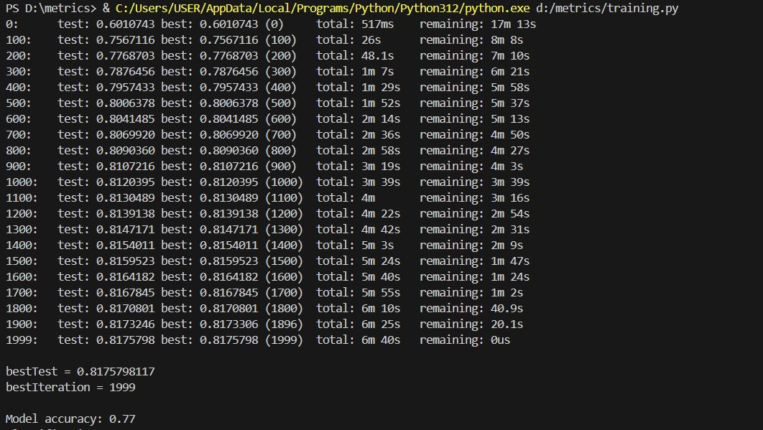
SAMPLE OUTPUT

Slide 19
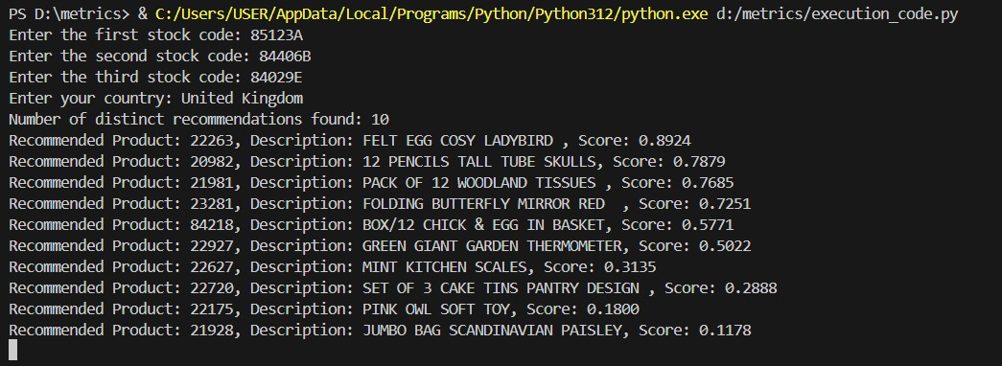
SAMPLE OUTPUT

Slide 20
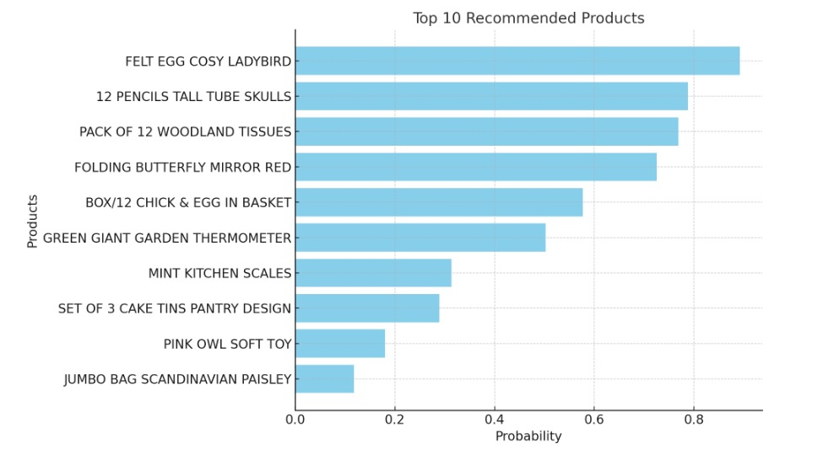
SAMPLE OUTPUT

Slide 21
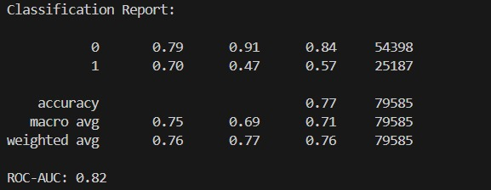
SAMPLE OUTPUT

Slide 22
CONCLUSION
The integration of advanced machine learning techniques significantly enhances the recommendation system's ability to predict customer preferences, enabling more accurate product suggestions.
By combining TF-IDF content analysis with collaborative filtering, the system effectively captures both product features and user interactions, improving recommendation accuracy and relevance.
The robust training and evaluation process ensures that the model is reliable and generalizable, offering consistent product recommendations even for new users or products.
The system's tailored recommendation features provide immediate, relevant suggestions based on user-selected products, enhancing the shopping experience.
Overall, the system promotes customer satisfaction and loyalty, empowering users with personalized shopping insights that drive better purchasing decisions.

Slide 23
FUTURE ENHANCEMENT
Enhance the recommendation system by adding climate data to adjust suggestions based on local weather conditions.
Use algorithms to prioritize products that match current climate conditions, helping customers find seasonally relevant items.
Update recommendations instantly with live weather and location data, keeping the system responsive to changing environments.
Incorporate customer feedback to continually refine and personalize recommendations.
Run marketing campaigns that highlight products suited for upcoming weather, increasing relevance and boosting sales.

Slide 24
REFERENCES
Ghulam mustafa, Naveed ahmad jhamat, Zeeshan arshad, Nadia yousaf(2024).”OntoCommerce: Incorporating Ontology and Sequential Pattern Mining for Personalized E-Commerce Recommendations” IEEE Explore , Issue on 18 March 2024 ,Vol.no:12.
Nitin Kamble.Ajeenkya D. Y. Patil University(2021).”Product Recommendation System using Machine Learning”,SSRN, Issue on 11, November 2021, Vol.no:9.
Jingyi Ding, Ziqing Chen, Li Xiaolong(2020).“Sales Forecasting Based on CatBoost”IEEE Explore , Issue on 2020, Vol.no:10.
Moon-Hee Park, Jin-Hyuk Hong, and Sung-Bae Cho(2007).”Location-Based Recommendation System Using Bayesian User's Preference Model in Mobile Devices[3]”Springer, Issue 2007, Vol.no.4611.
R. Kirubahari and S. Miruna Joe Amali(2024). "An Improved Restricted Boltzmann Machine Using Bayesian Optimization for Recommender Systems."Evolving Systems, Vol.15(3), pp.1099-1111.

Slide 25
THANK YOU

